Slide 1
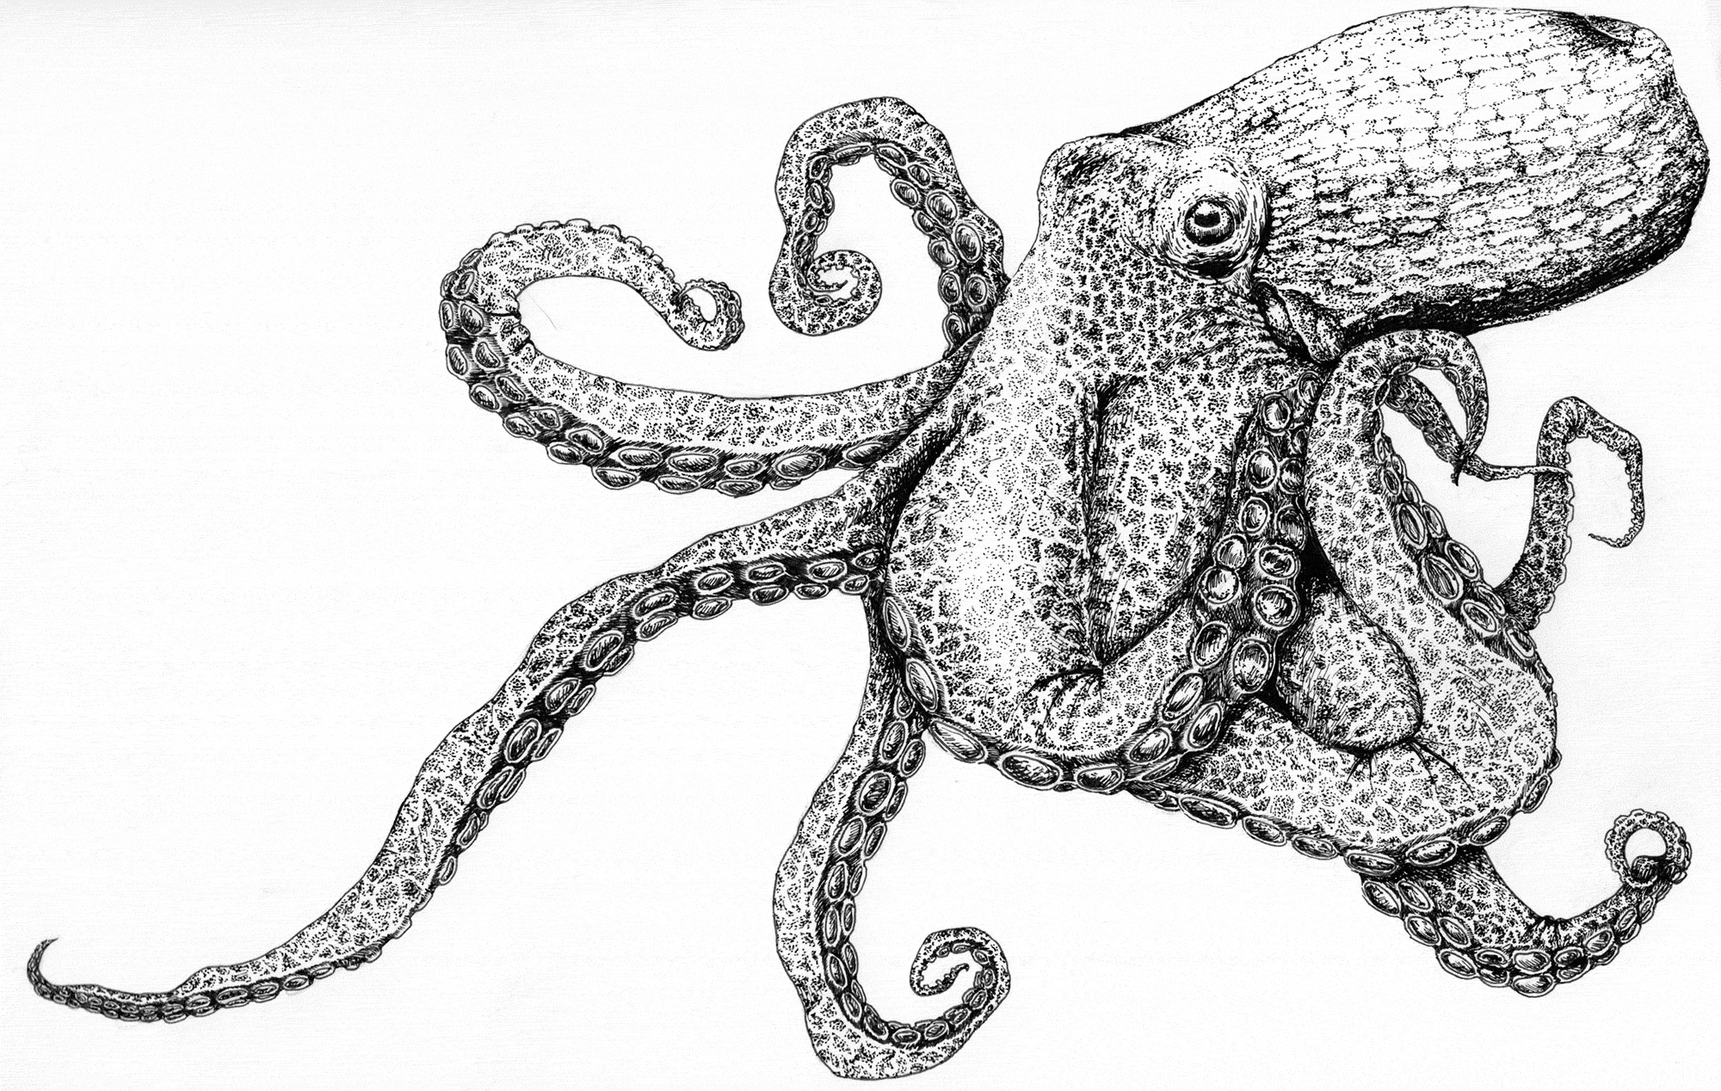
BSAI Octopus
 | As estimated or specified last year for: |  | As estimated or recommended this year for:
Quantity/Status | 2023 | 2024 | 2024 | 2025
Tier | 6 | 6 | 6 | 6
OFL (t) | 4,769 | 4,769 | 6,080 | 6,080
maxABC (t) | 3,576 | 3,576 | 4,560 | 4,560
ABC (t) | 3,576 | 3,576 | 4,560 | 4,560
 | As determined last year for: |  | As determined this year for:
Status | 2021 | 2022 | 2022 | 2023
Overfishing | No | n/a | No | n/a
Point estimate derived from P. cod (Octopus’s main predator) diet data
13,614 P. cod stomachs from 2012-2013 and 2016-2023 added

Slide 2
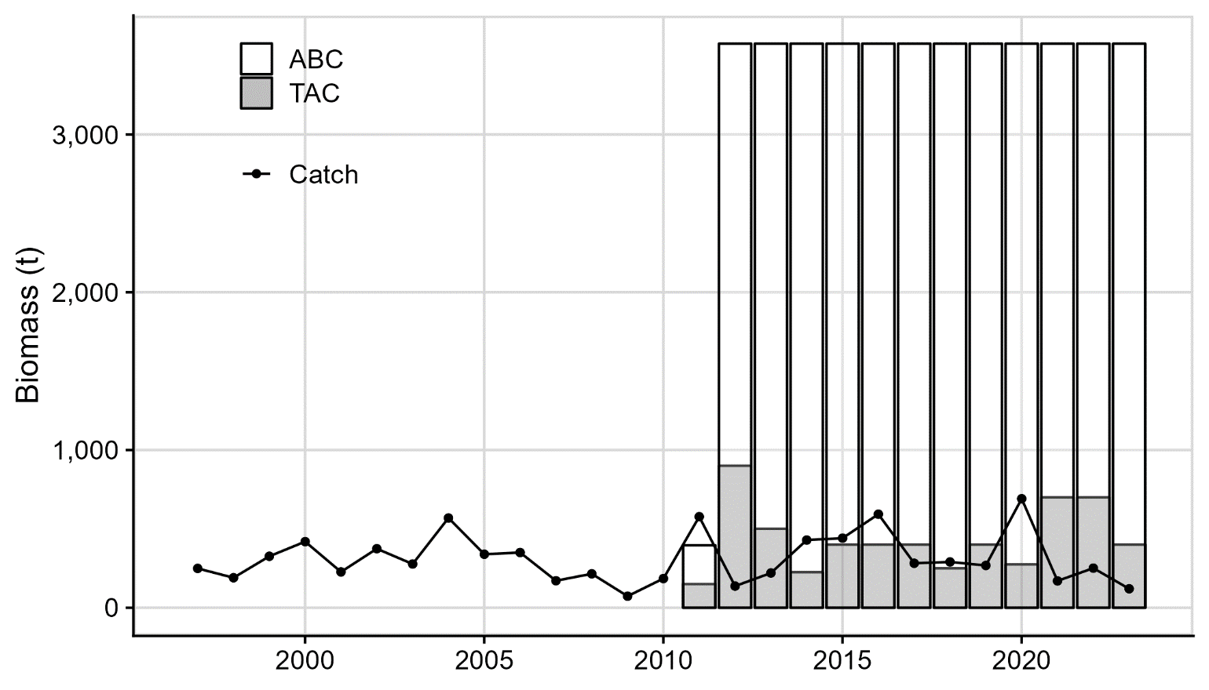
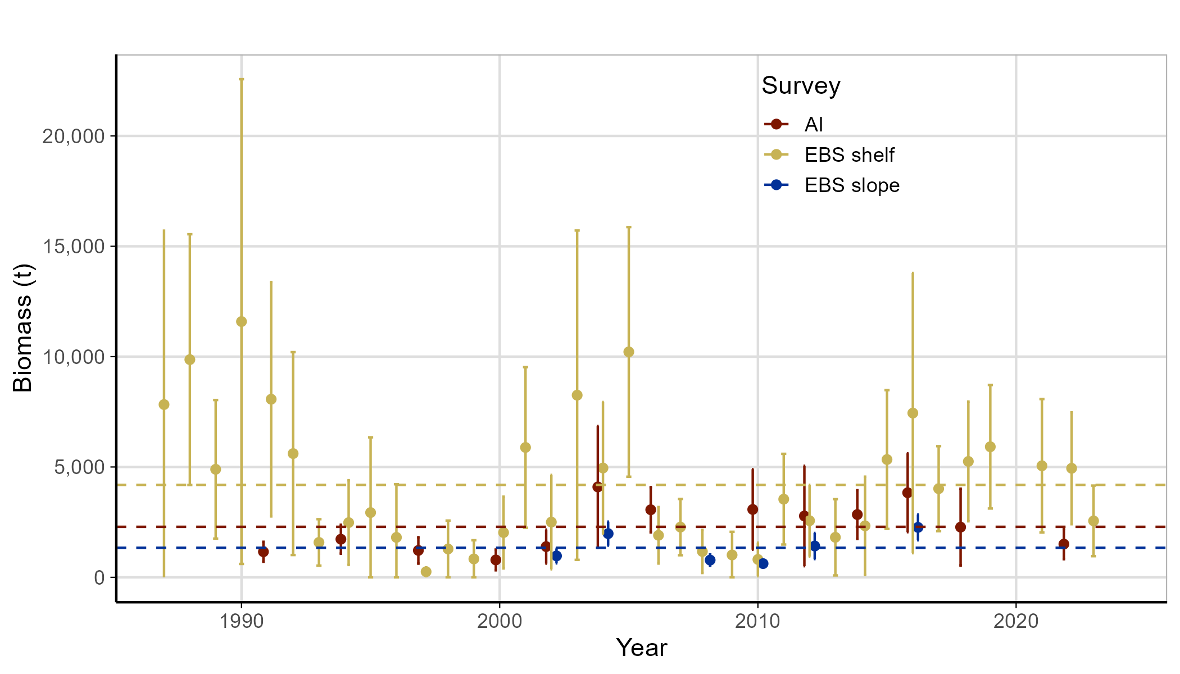
BSAI Octopus

